Slide 1

LDBC
Linked Data Benchmark Council
2-year status report
Peter Boncz

Slide 2
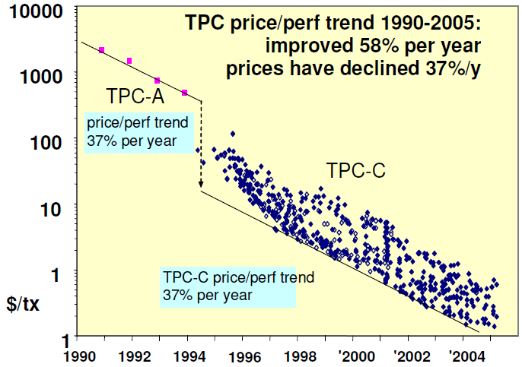
Why Benchmarking?
make competing products comparable
accelerate progress, make technology viable
© Jim Gray, 2005

Slide 3
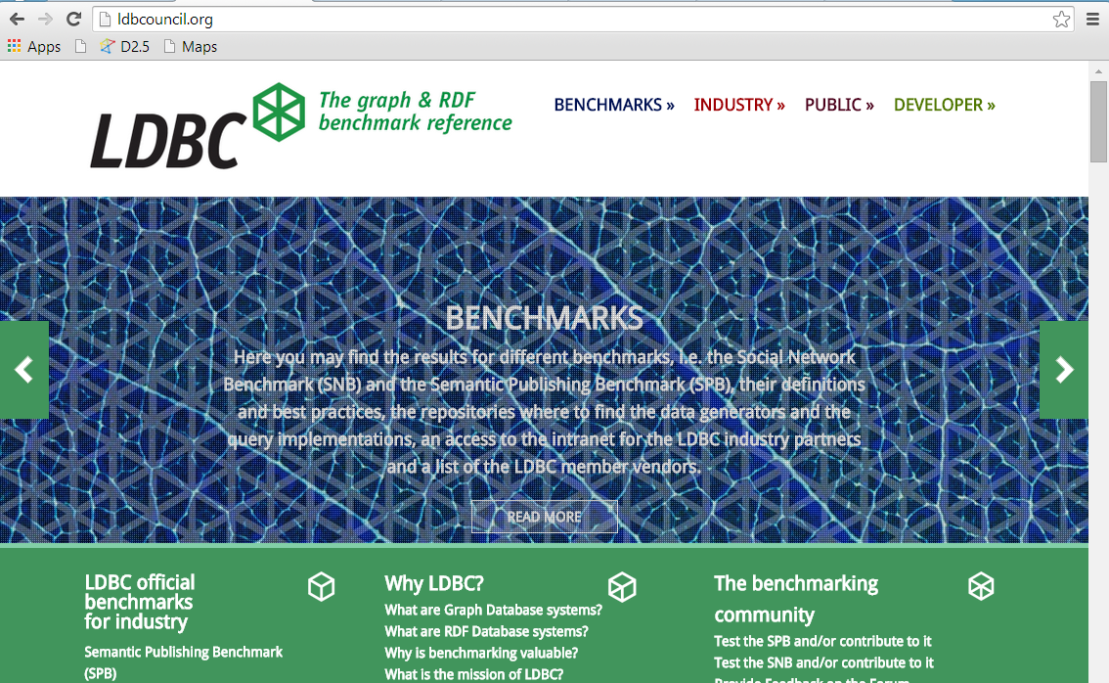
ldbcouncil.org

Slide 4
LDBC: what systems?
Benchmarks for:
Graph Database systems
  Neo4j, DEX, InfiniteGraph, …
RDF stores (SPARQL speaking)
  Virtuoso, OWLIM, BigData, Allegrograph,…
Graph Programming Frameworks
  Giraph, Green Marl, Grappa, GraphLab,…
Relational Database systems

Slide 5








Industry Membership

Slide 6
What is LDBC doing now?
Two main “task forces”:
Semantic Publishing Benchmark (SPB)
  BBC use case – RDF oriented
  Possible Extensions
    Instance matching (SPIMbench)
    “Mapping Management” (Open PHACTS)
    Reasoning (beyond RDFS)
Social Network Benchmark (SNB)
  Interactive workload (ready)
  BI workload
  Graph algorithms workload
See: github.com/LDBC

Slide 7
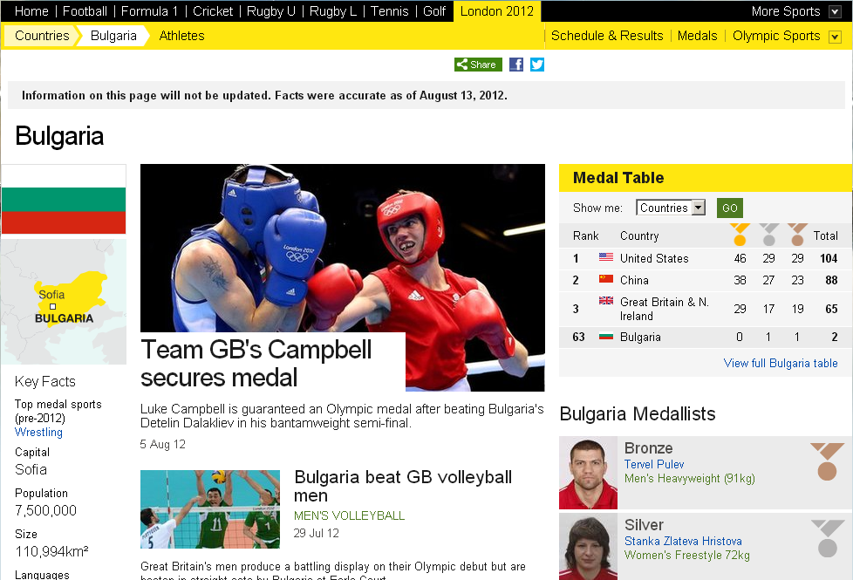
Semantic Publishing Benchmark (SPB)

Slide 8
SNB: Workloads
Interactive: tests a system's throughput with relatively simple queries with concurrent updates
  Show all photos posted by my friends that I was tagged in
Business Intelligence: consists of complex structured queries for analyzing online behavior
  Influential people the topic of open source development?
Graph Analytics: tests the functionality and scalability on most of the data as a single operation
  PageRank, Shortest Path(s), Community Detection

Slide 9
LDBC Roadmap
EU project almost done
  5 months left
  LDBC non-profit company takes over
5th Technical User Community Meeting
  Nov 14, Athens
  Probably a 6th TUC in March Barcelona
Focus on Benchmark Results
  Officially adopt SNB + SPB
  Produce Audited Results

